Slide 1

Principle 8: Adopt and Adapt Technology That Supports Your People and Processes
Hailey Skoglund & Gus Lipkin

Slide 2
COMPUTERS PROCESS THE INFORMATION. PEOPLE DO THE THINKING.
Technology cannot replace people
Behind every piece of equipment, there was a person’s creative idea to improve the process
Example: Parallel Study
With New Technology:
Automated inventory tracking software
Keeping track of inventory on the computer does not fix the problem, it just provides visibility into the current process
Without New Technology:
Sustainable inventory control was achieved by people actively improving the process
A manual pull system, using Kanban, reduced their inventory problem by 80%

Slide 3
TECHNOLOGY IS A TOOL, NOT A GOAL.
Implementing the latest information technology is not a business goal at Toyota
Facility automation is not always representative of its productivity levels
“Toyota’s most productive regional parts depot was in Cincinnati, where there was very little automation.”
“You can kaizen people processes very easily, but it is hard to kaizen a machine.”

Slide 4
AUTOMATION AND EQUIPMENT CAN ALSO BE IMPROVED BY CREATIVE, THINKING PEOPLE
Visualize production.
Develop explicit knowledge of the process.
Standardize the knowledge.
Develop intelligent automation through kaizen.

Slide 5
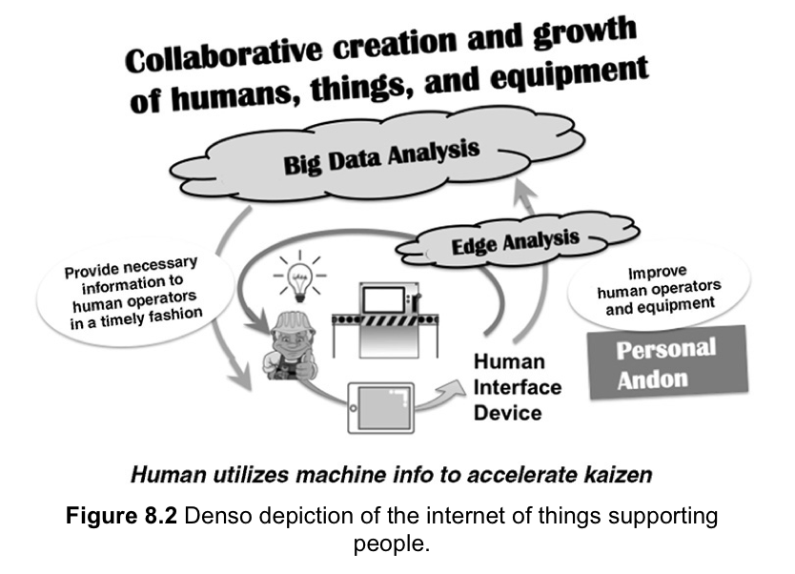
DOES THE TECHNOLOGY DESKILL, REPLACE, OR ENHANCE?

Slide 6
BALANCING THE RUSH FOR THE LATEST TECHNOLOGY WITH EFFECTIVENESS
Departments must be able to prove that new technology is viable and adds value
Slow rollout in stages to work out the kinks rather than rapid rollout all at once
Just because it works on paper, doesn’t mean it’ll work in practice

Slide 7
KEY POINTS
Focusing only on automated equipment can lead to too much money tied up in fixed capital costs.
“Simple, slim, and flexible”
Right balance of people and automation
Continuous improvement of automated equipment can help organizations move closer to the lean vision of one-piece flow without interruption.
Building upon Toyota Production System (TPS) principles can open doors to real-time, continuous information to accelerate and amplify kaizen.
Toyota prioritizes people over automated equipment

Slide 8
BUT WHAT DOES THIS HAVE TO DO WITH LEMONS?
If you just jump in and eat a lemon, it’ll be sour and probably not great. If you take time to learn about the lemon, you’ll discover its many wonderful properties and how it can really add to your dishes.

Slide 9
Principle 8: Adopt and Adapt Technology That Supports Your People and Processes
Hailey Skoglund & Gus Lipkin

